Slide 1
函数式编程原理 Lecture 5

Slide 2
上节课内容回顾
以排序算法为例
list类型的应用
插入排序(Insertion Sort)
ins : int * int list -> int list
isort : int list -> int list
程序描述、编码及正确性验证

Slide 3
整数的插入——ins
ins : int * int list -> int list
(* REQUIRES L is a sorted list *)
(* ENSURES ins(x, L) = a sorted perm of x::L *)
fun ins (x, [ ]) = [x]
| ins (x, y::L) = case compare(x, y) of
GREATER => y::ins(x, L)
| _ => x::y::L
For all sorted integer lists L,
ins(x, L) = a sorted permutation of x::L.

Slide 4
插入排序——isort
isort : int list -> int list
(* REQUIRES true *)
(* ENSURES isort(L) = a sorted perm of L *)
fun isort [ ] = [ ]
| isort (x::L) = ins (x, isort L)
For all integer lists L,
isort L = a sorted permutation of L.

Slide 5
插入排序——isort
isort : int list -> int list
(* REQUIRES true *)
(* ENSURES isort(L) = a sorted perm of L *)
fun isort [ ] = [ ]
| isort (x::L) = ins (x, isort L)
[5, 4, 3, 2, 1]怎么排的？

Slide 6
插入排序——isort
[5, 4, 3, 2, 1]怎么排的？
isort : int list -> int list
fun isort [ ] = [ ]
| isort (x::L) = ins (x, isort L)
isort (5::[4, …, 1])
= ins (5, isort [4, …, 1])
= ins (5, ins(4, isort [3, 2, 1]))
= ins (5, ins(4, ins(3, isort [2, 1]))
= ins (5, ins(4, ins(3, ins(2, isort[1])))
= ins (5, ins(4, ins(3, ins(2, [1])))
= …

Slide 7
插入排序——isort

Slide 8
插入排序——isort

Slide 9
另一个插入排序——isort’
isort’ : int list -> int list
fun isort’ [ ] = [ ]
| isort’ [x] = [x]
| isort’ (x::L) = ins (x, isort’ L);
isort and isort’ are extensionally equivalent.
For all L : int list, isort L = isort’ L.

Slide 10
归并排序
基本思想：采用分治法（Divide and Conquer）将已有序的子序列合并，得到完全有序的序列；即先使每个子序列有序，再使子序列段间有序。
操作步骤：
将n个元素分成两个含n/2元素的子序列
将两个子序列递归排序
合并两个已排序好的序列
split : int list -> int list * int list
merge : int list * int list -> int list

Slide 11
善于使用帮助(helper)函数
如何实现更加复杂的函数功能？
状态的记录和改变
更复杂的递归
Helper functions

Slide 12
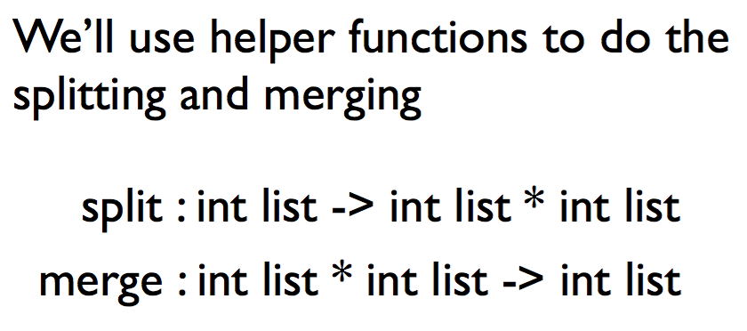
善于使用帮助(helper)函数

Slide 13
表的分割——split
split : int list -> int list * int list
(* REQUIRES true *)
(* ENSURES split(L) = a pair of lists (A, B) *)
(* such that length(A) and length(B) differ by at most 1, *)
(* and A@B is a permutation of L. *)
fun split [ ] = ([ ], [ ])
| split [x] = ([x], [ ])
| split (x::y::L) =
let val (A, B) =split L
in (x::A, y::B)
end
能否去掉？
For all L:int list,
split(L) = a pair of lists (A, B) such that
length(A) ≈ length(B) and A@B is a permutation of L.
如何证明？

Slide 14
用归纳法证明split函数的正确性
根据L的长度用完全归纳法进行证明
1. L = [ ], [x]
①split [ ] = a pair (A, B) such that length(A)≈length(B) & A@B is a perm of [ ].
②split [x] = a pair (A, B) such that length(A)≈length(B) & A@B is a perm of [x].
2. 假设split(R) = a pair (A’, B’) such that length(A’)≈length(B’) & A’@B’ is a perm of R.
证明: split(L) = a pair (A, B) such that length(A)≈length(B) & A@B is a perm of x::y::R. (L=x::y::R)

Slide 15
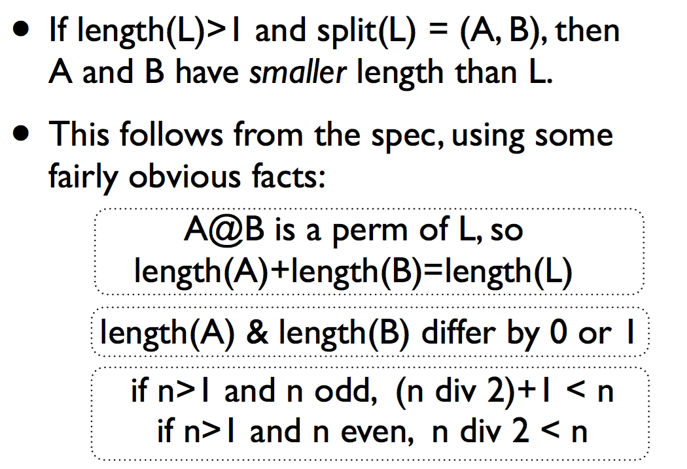
split函数的特点

Slide 16
表的分割——split
[5, 4, 3, 2, 1]怎么split的？
split : int list -> int list * int list
fun split [ ] = ([ ], [ ])
| split [x] = ([x], [ ])
| split (x::y::L) =
let val (A, B) =split L
in (x::A, y::B)
end
split (5::4::[3, 2, 1])
= split (5::4::split(3::2::split[1]))
= split (5::4::split(3::[1], 2::[ ]))
= 5::[3, 1], 4::[2]
= [5,3,1], [4,2]

Slide 17
表的合并——merge
merge : int list * int list -> int list
(* REQUIRES A and B are <-sorted lists *)
(* ENSURES merge(A, B) = a <-sorted perm of A@B *)
fun merge (A, [ ]) = A
| merge ([ ], B) = B
| merge (x::A, y::B) = case compare(x, y) of
LESS => x :: merge(A, y::B)
| EQUAL => x::y::merge(A, B)
| GREATER => y :: merge(x::A, B)
能否写成： merge([], []) = []?
如何证明？

Slide 18
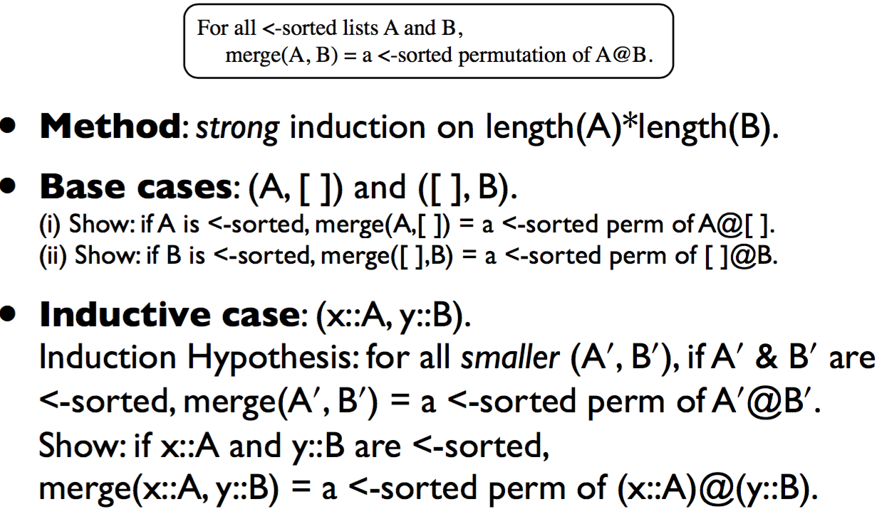
用归纳法证明Merge函数的正确性

Slide 19
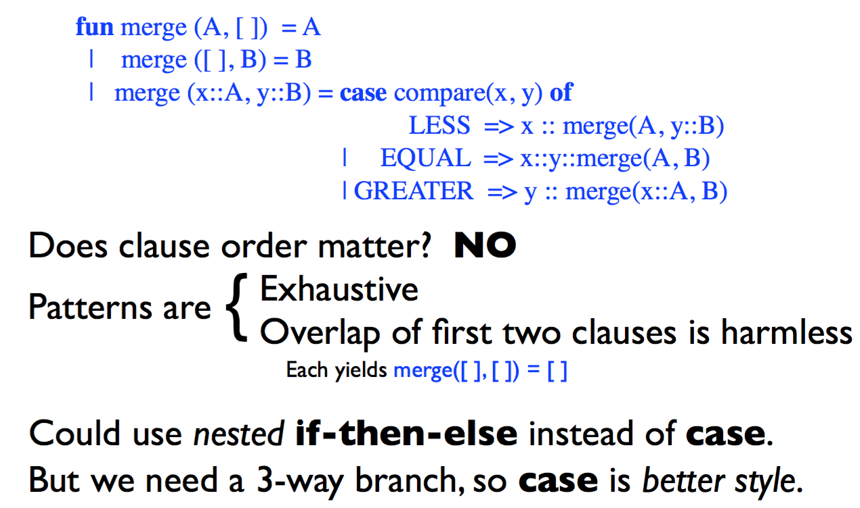
Merge函数的特点

Slide 20
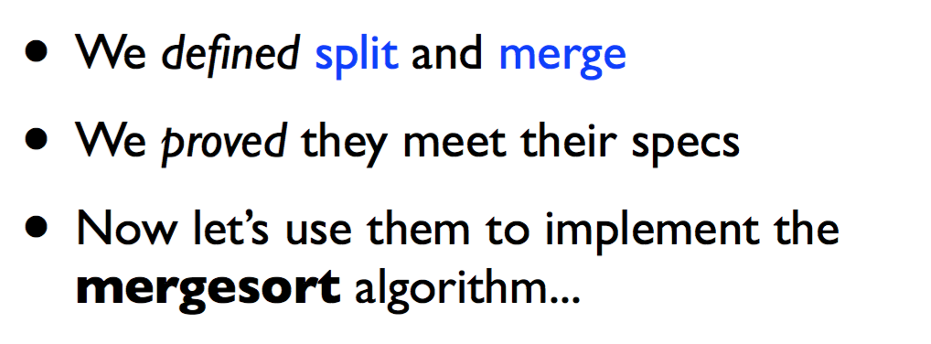
开始使用帮助(helper)函数

Slide 21
归并排序—— mergesort
msort : int list -> int list
(* REQUIRES true *)
(* ENSURES msort(L) = a <-sorted perm of L *)
fun msort [ ] = [ ]
| msort [x] = [x]
| msort L = let
val (A, B) = split L
in
merge (msort A, msort B)
end
能否去掉？
msort [1] =
=> merge(msort[1], msort[])
merge(merge(msort[1], msort[]), … ))
不断拆分split[x]

Slide 22
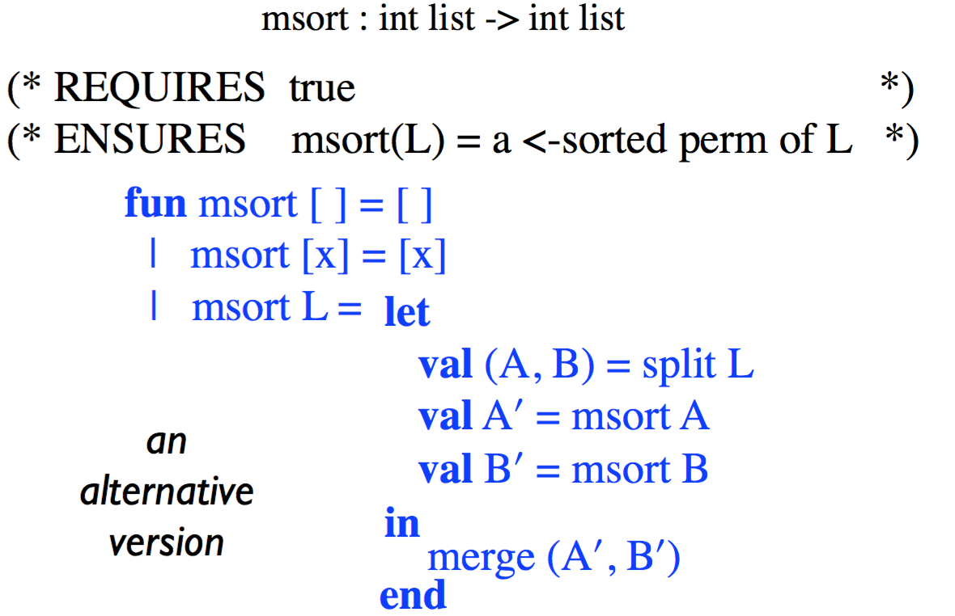
归并排序—— mergesort

Slide 23
归并排序
fun split [ ] = ([ ], [ ])
| split [x] = ([x], [ ])
| split (x::y::L) =
let val (A, B) =split L
in (x::A, y::B)
end
fun merge (A, [ ]) = A
| merge ([ ], B) = B
| merge (x::A, y::B) = case compare(x, y) of
LESS => x :: merge(A, y::B)
| EQUAL => x::y::merge(A, B)
| GREATER => y :: merge(x::A, B)
fun msort [ ] = [ ]
| msort [x] = [x]
| msort L = let val (A, B) = split L
in merge (msort A, msort B)
end

Slide 24
msort的正确性验证
fun msort [ ] = [ ]
| msort [x] = [x]
| msort L = let
val (A, B) = split L
in
merge (msort A, msort B)
end
For all L:int list, if length(L)>1
then split(L) = (A, B)
where A and B have shorter length than L
and A@B is a permutation of L
For all L:int list,
msort(L) = a <-sorted permutation of L.
For all sorted lists A and B,
merge(A, B)= a sorted permutation of A@B

Slide 25
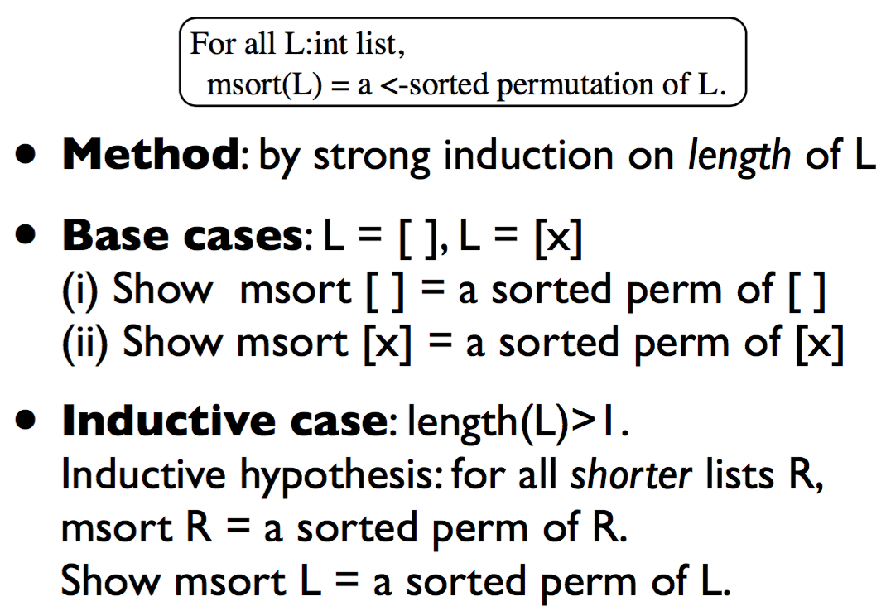
msort的正确性验证

Slide 26
ML编程原则(principles)
每个函数都对应一个功能描述说明 (Every function needs a spec)
需要验证程序符合功能描述说明 (Every spec needs a proof)
用归纳法进行递归函数的正确性验证 (Recursive functions need inductive proofs)
选取合适的归纳法 (Learn to pick an appropriate method...)
设计恰当的帮助函数 (Choose helper functions wisely)
msort的证明非常简单，源于函数split and merge的使用

Slide 27
功能说明的作用 (the joy of specs)
函数的证明有时依赖于某个被调用函数的证明结果(符合spec要求)
The proof for msort relied only on the specification proven for split (and the specification proven for merge)
被调用函数可以由具有相同功能说明的其他函数替换，而且证明过程仍然有效
In the definition of msort we can replace split by any function that satisfies this specification, and the proof will still be valid, for the new version of msort

Slide 28
函数替换举例
fun msort’ [ ] = [ ]
| msor’t [x] = [x]
| msort’ L = let
val (A, B) = split’ L
in merge (msort’ A, msort’ B)
end
fun split’ [ ] = ([ ], [ ])
| split’ [x] = ([ ], [x])
| split’ (x::y::L) =
let val (A, B) =split’ L
in (x::A, y::B)
end
尽管split和split’函数不相同，但他们都满足整数表分割功能，在正确性证明过程中没有区别，所以函数msort和mosrt’都是正确的。

Slide 29
插入排序程序性能分析
fun ins (x, [ ]) = [x]
| ins (x, y::L) = case compare(x, y) of
GREATER => y::ins(x, L)
| _ => x::y::L
W_{ins}(n): the work for ins(x, L) (length L =n)
W_{ins}(n) is O(n)
fun isort [ ] = [ ]
| isort (x::L) = ins (x, isort L)
W_{isort}(n): the work for isort(L) (length L = n)
W_{isort}(n) is O(n²)

Slide 30
归并排序程序性能分析
merge (A, [ ]) = A
| merge ([ ], B) = B
| merge (x::A, y::B) = case compare(x, y) of
LESS => x :: merge(A, y::B)
| EQUAL => x::y::merge(A, B)
| GREATER => y :: merge(x::A, B)
fun split [ ] = ([ ], [ ])
| split [x] = ([x], [ ])
| split (x::y::L) =
let val (A, B) =split L in (x::A, y::B)
end
W_{split}(n): work of split(L) (length(L)=n)
W_{split}(n) is O(n)
W_{merge}(n): work of merge(A,B) (length(A)+length(B)=n)
W_{merge}(n) is O(n)

Slide 31
归并排序程序性能分析
fun msort [ ] = [ ]
| msort [x] = [x]
| msort L = let
val (A, B) = split L
in
merge (msort A, msort B)
end
W_{mosrt}(n): work of msort(L) (length(L)=n)
W_{msort}(n) is O(n log n)
有没有新的数据类型能并发执行？
Tree结构
用树结构进行排序
msort(L)性能优于isort(L)，还能继续提升性能吗？
从程序算法上考虑：……
从数据结构上考虑：List结构为线性（顺序）结构（在[ ]基础上利用’::’进行线性扩展），因此很难提升性能（无法并发/并行）

